Slide 1
Project work: DBHost
Author: Tibor Péter Szabó
GitHub: DBHost
Matriculation Number: 92124338
Subject: Project: Java and Web Development (DLBCSPJWD01)
Tutor: Sandra Rebholz

Slide 2
Purpose of the application:
This application was designed to aid company personnel to manage other employees and assets.
The application provides secure login, with different access levels to allow or disallow the usage of the different commands of the program.
The application mainly focuses on storing and displaying data about employees, like their location, their availability.
The application is highly extendable due to the fact, that the commands that can be executed are stored in a SQL table as well for easy scalability.

Slide 3
Architecture
Browsers
(The user can access data through the website, and have ability to login, and request new information from the webserver)
Front-end
HTTP Request / HTTP Response
Back-end
Reads data from the tables in the database
Creates a SQL query towards the SQLite3 engine
Java web socket
(Accepts new-coming connections from the web)
Reads data from the files on the disk
User data
login.html
SQLite3 Database engine
(Manages database queries)
Provides data from files
Operating systems’ file system manager
(Provides access to local files)
Get user session
Employee data
ServingManager object instance.
(Parses the request of the user, handles authentication, prepares response, requests and reads files from the operating system)
main.html
Machines data
table.html
Workgroup data
Request data from the database
Crypto.js
DBManager class
(Manages and formats the SQL database query)

Slide 4
Example scenario
Front-end
User “admin”
Logs in.
User “Skylar”
Requests employees.
User: admin
Pass: admin
Get employees
Back-end
Java web socket
User session of Skylar
User session of admin
User data
Query
User data
login.html
Get main page
SQLite3 Database engine
ServingManager object instance.
ServingManager object instance.
Operating systems’ file system manager
Employee data
SQL query
Read main.html
main.html
Query
Employee data
Query
Employees
Query
accounts
Machines data
table.html
DBManager class
Workgroup data
Crypto.js
SQL query

Slide 5
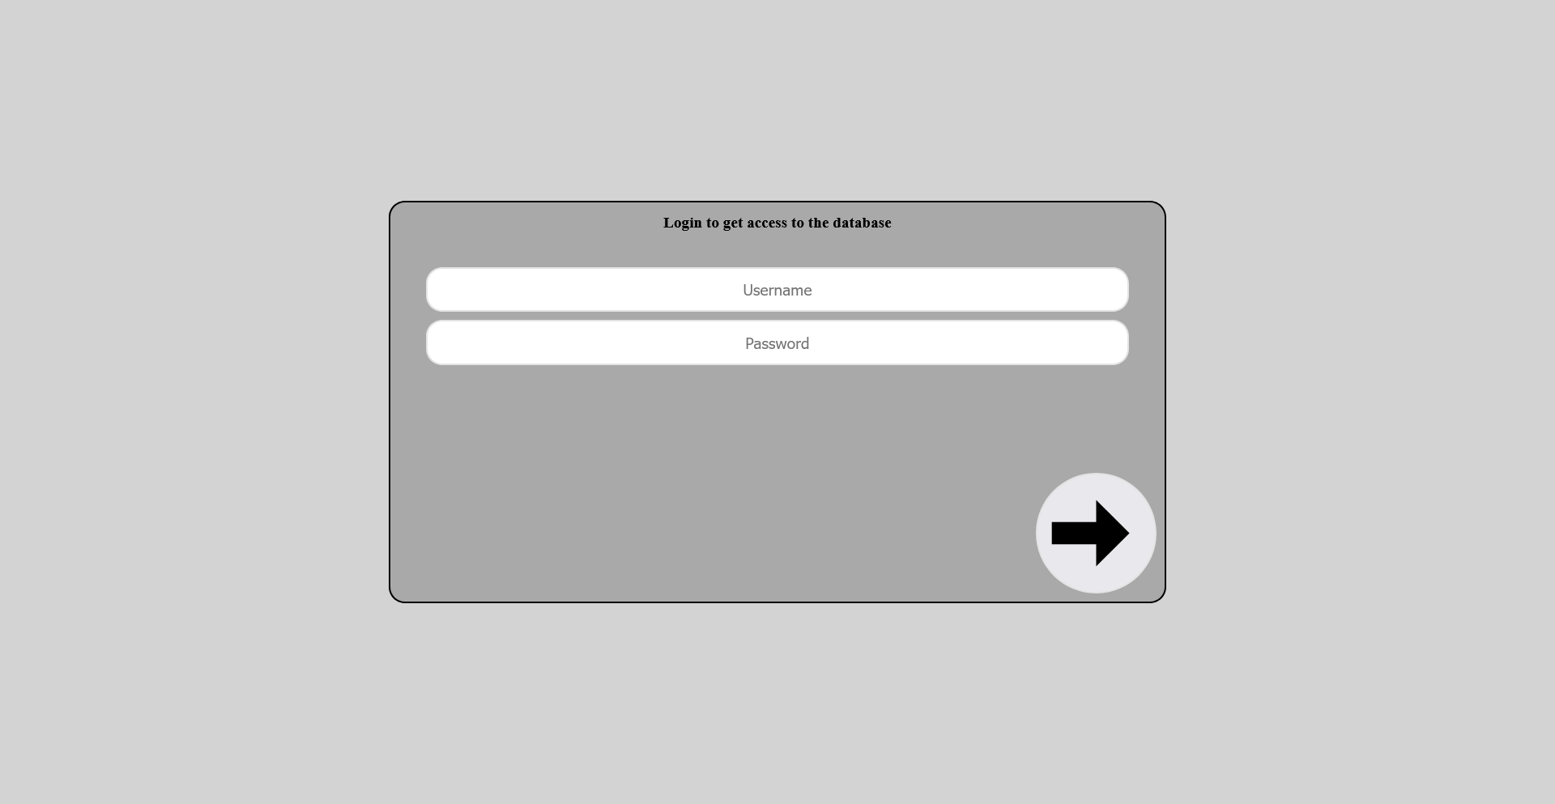
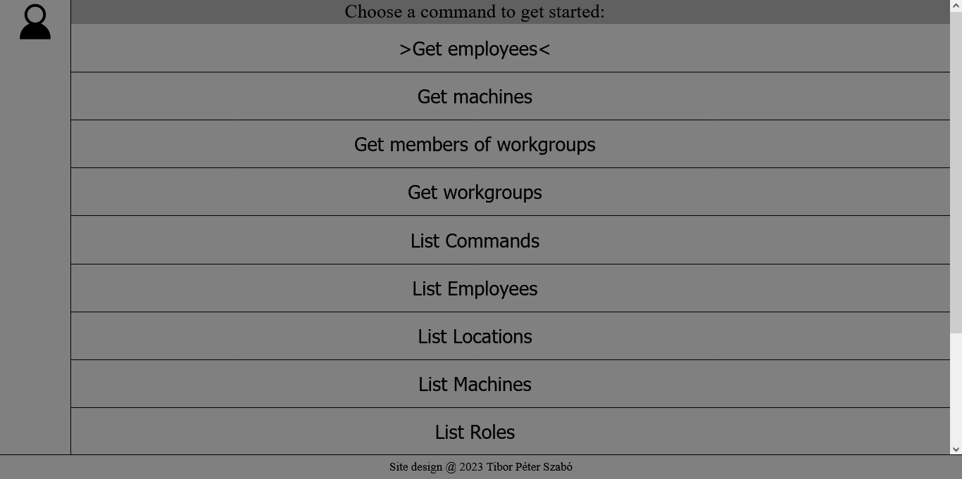
Site display on Desktop
Login Page
Username and Password input
Login button
Profile menu button
Starting Page
List of commands

Slide 6
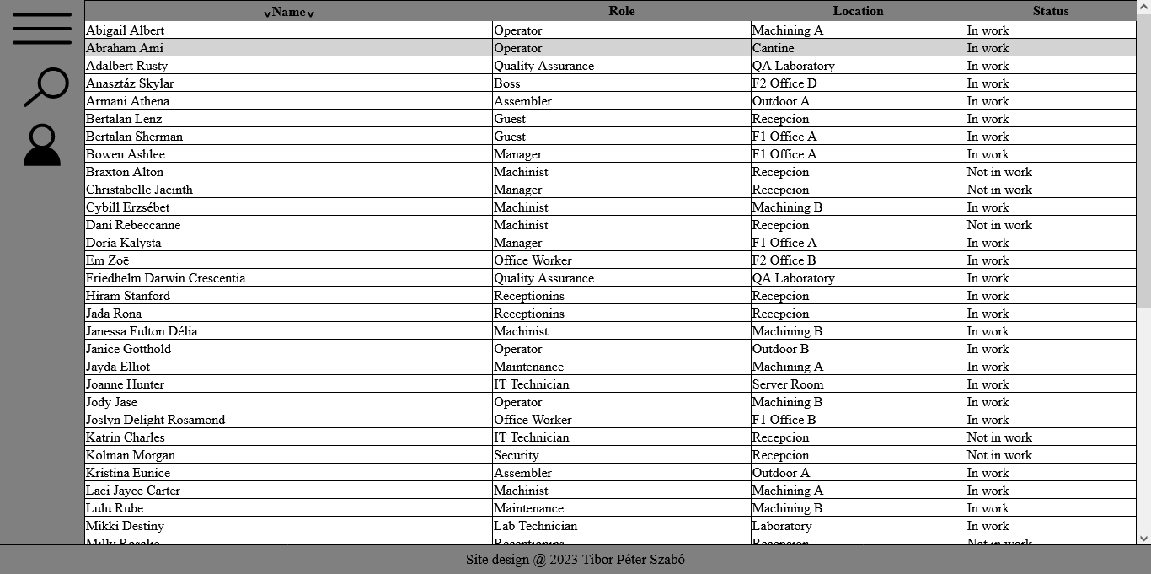
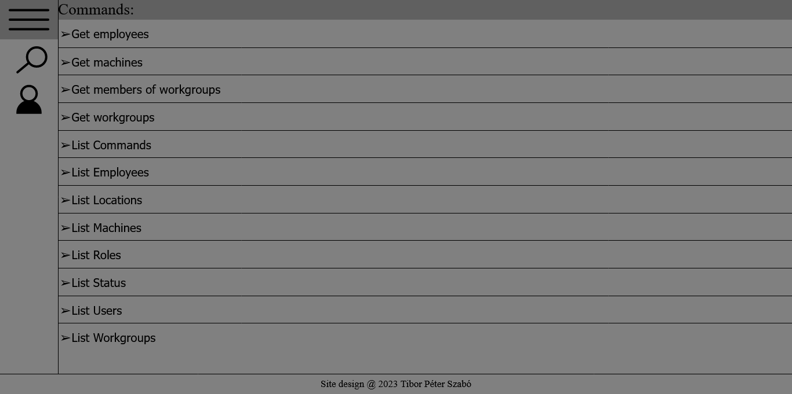
Site display on Desktop
Commands menu button
Table display Page
Filter menu button
Profile menu button
Displayed data
Commands menu button
Commands Menu
Filter menu button
Profile menu button
List of commands

Slide 7
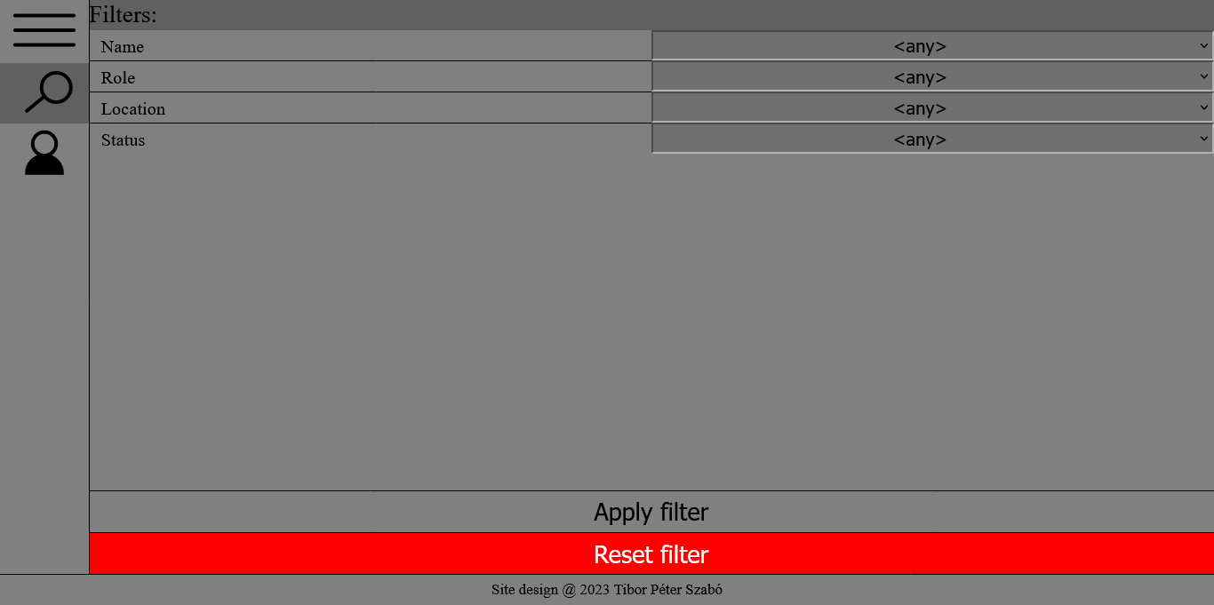
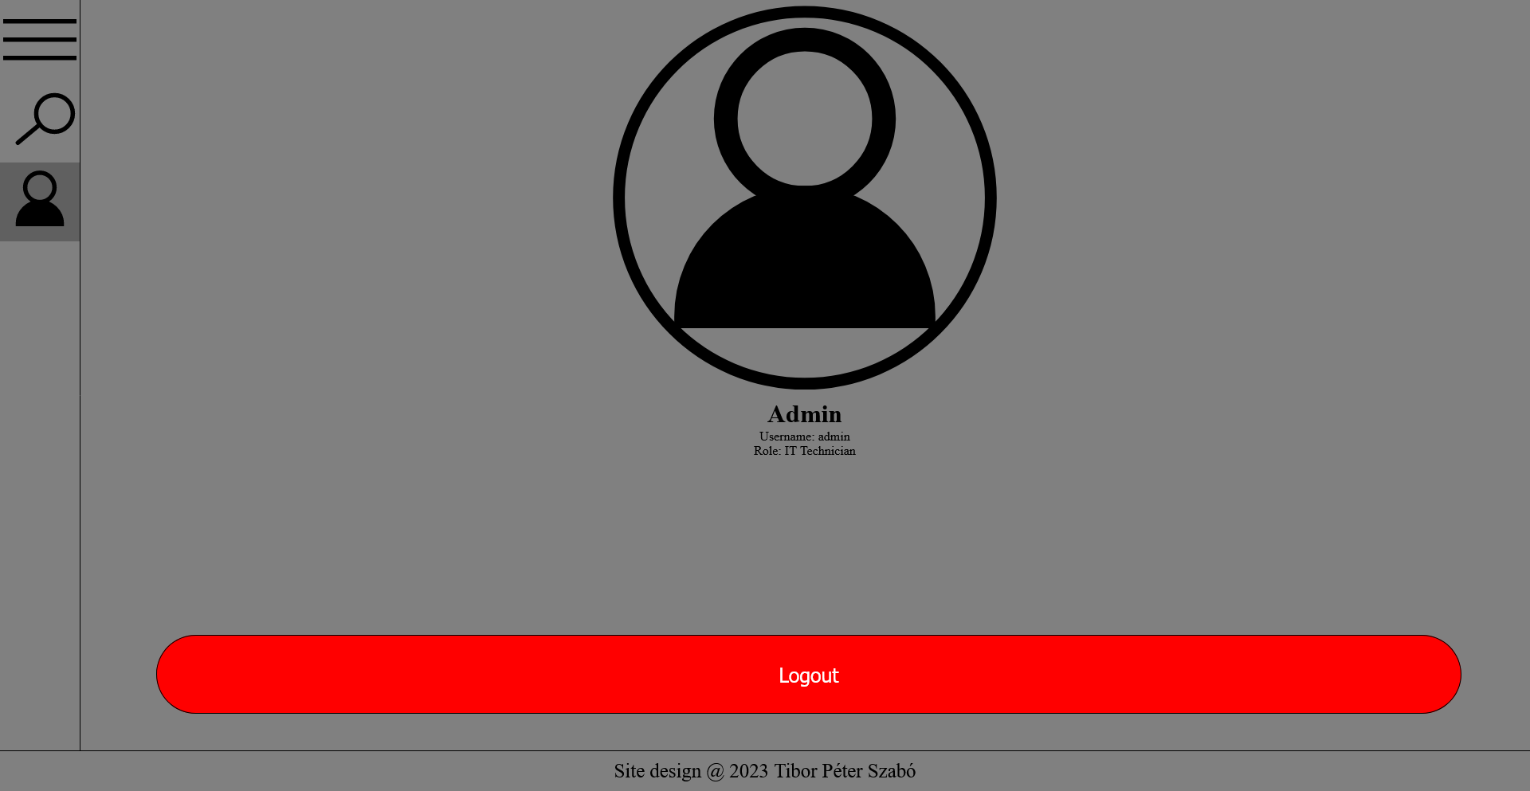
Site display on Desktop
Commands menu button
Login Page
Filter menu button
Profile menu button
List of filters
Apply selected filters
Reset filters
Commands menu button
Starting Page
Filter menu button
Profile menu button
Information about the user
Log out

Slide 8
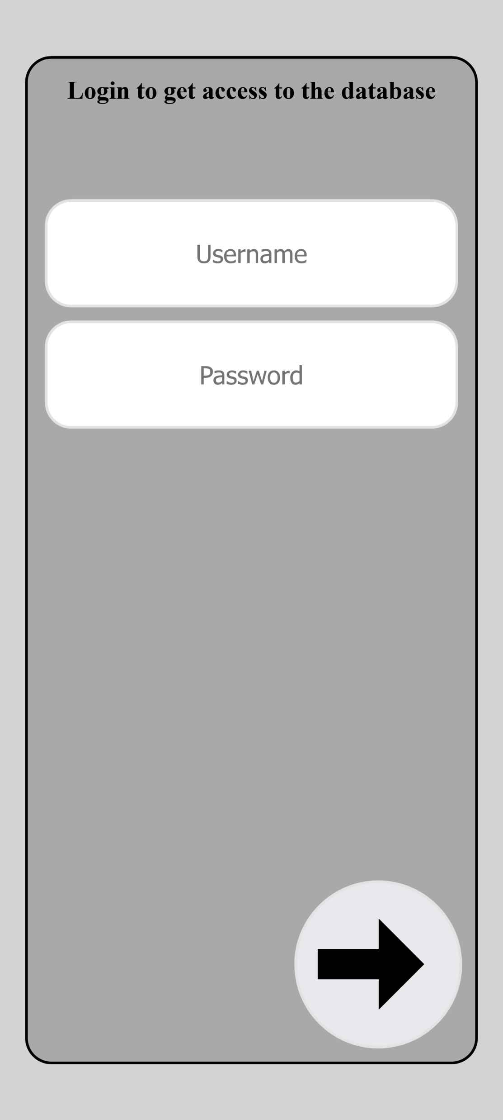
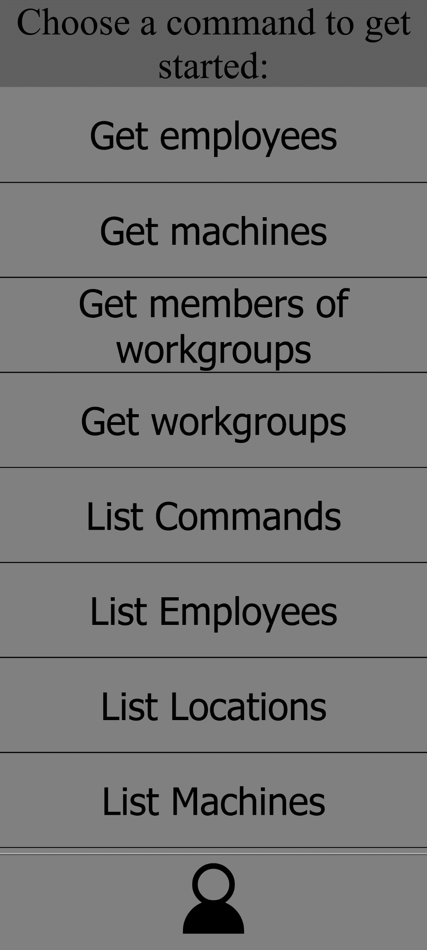
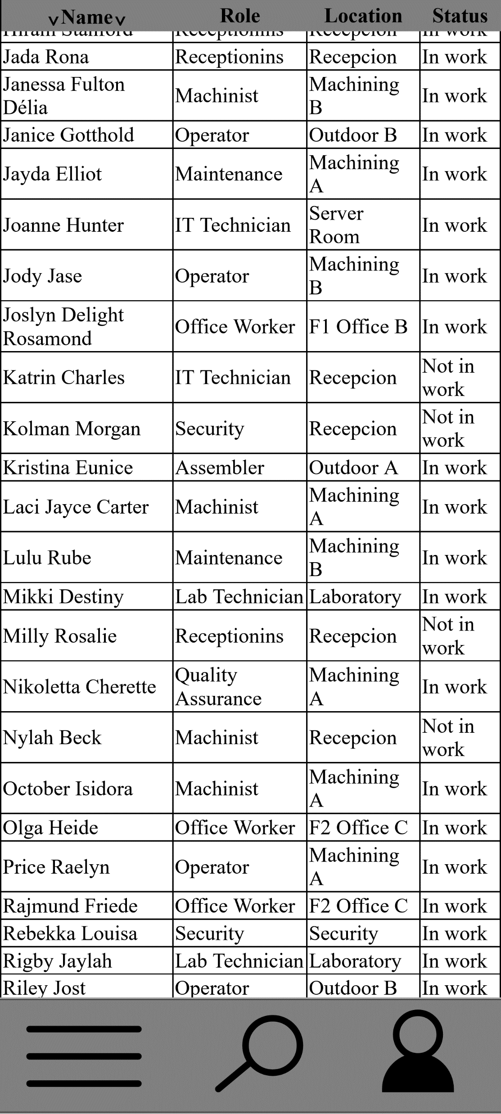
Site display on Mobile
Failed to load: Image of Login Page
Failed to load: Image of starting page
Failed to load: Image of data display
Login Page
Starting Page
Data Display Page

Slide 9
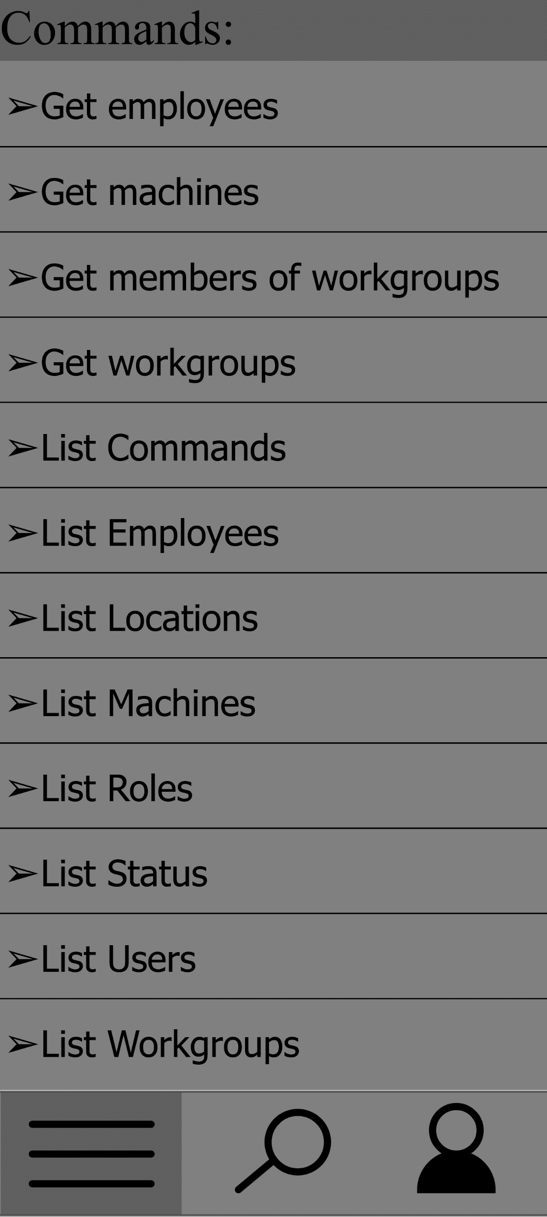
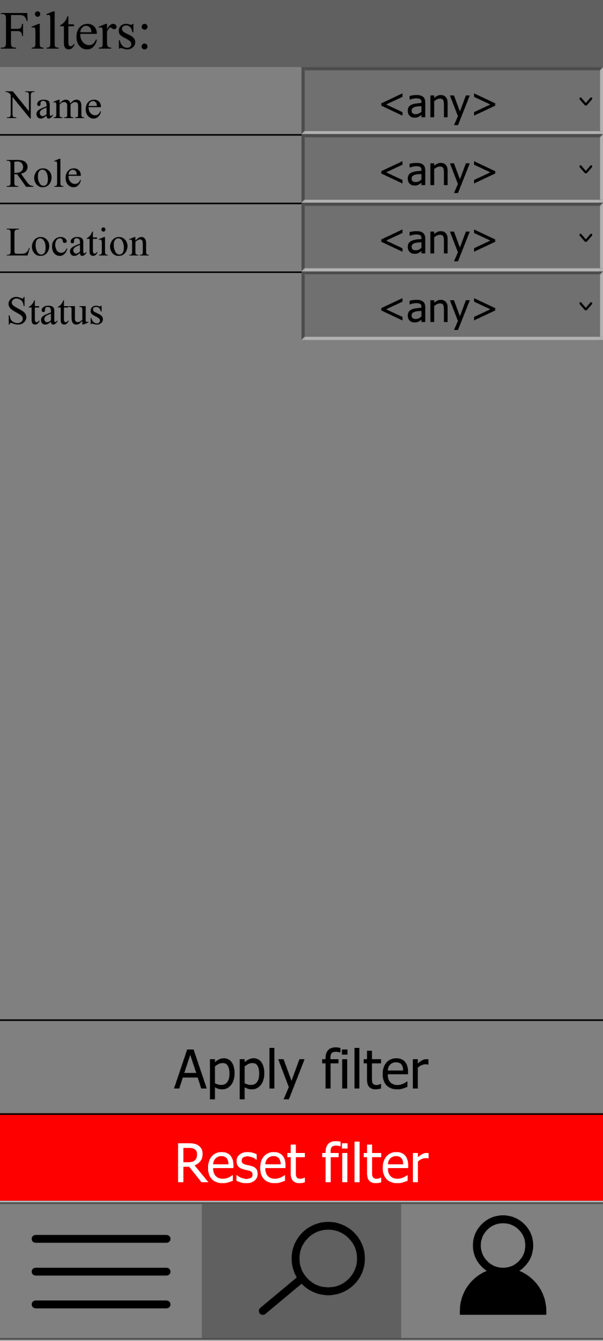
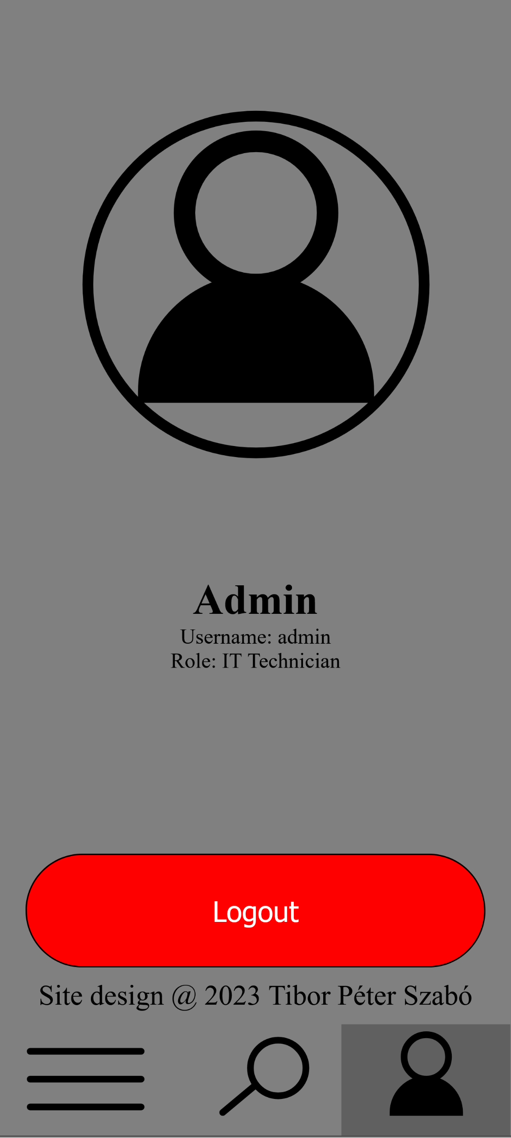
Site display on Mobile
Failed to load: Image of commands menu
Failed to load: Image of filter menu
Failed to load: Image of profile menu
Commands Menu
Filter Menu
Profile Menu

Slide 10
Changes
Used technologies
Back-end | Communication | Front-end
Java | HTTP | HTML
SQL | XMLRequest | JavaScript
 |  | CSS
Concept | End result | Reason
Custom SQL queries | Left unimplemented | Risk of SQL Injection vulnerability
Bootstrap.css library | Pure CSS code | Much higher style customizability
HTTP Auth protocol | HTTP cookie | HTTP Auth protocol was not flexible enough to use it as a possible solution for login UI.

Slide 11
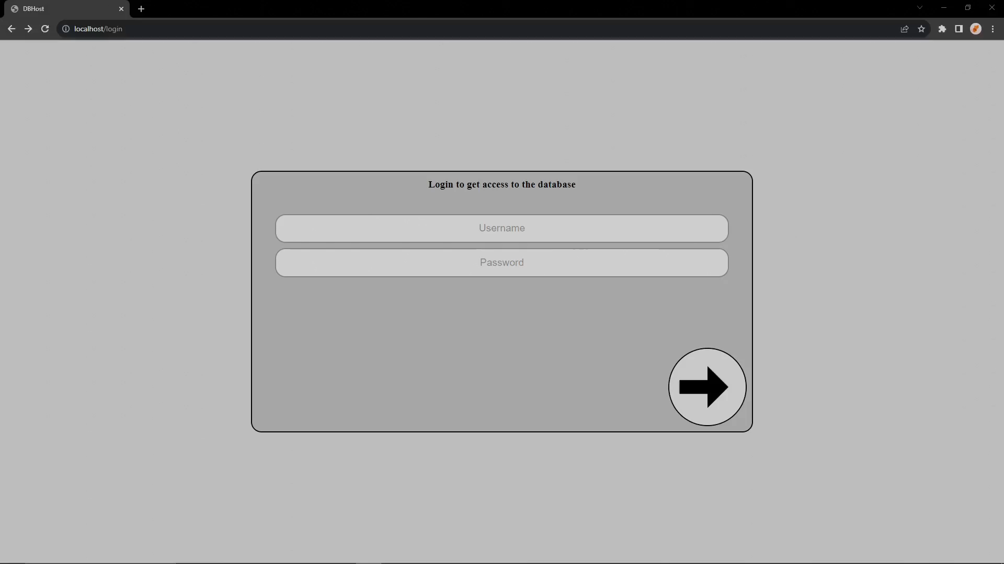
Video demonstration of the website

